Slide 1
Course Overview
CIS 265 – Visual Basic

Slide 2
About Me
Kevin Hall (Professor Hall)
Radford University
B.S. Computer Science
University of Maryland Baltimore County
M.S. Engineering Management, Systems Engineering specialization
M.P.S. Cybersecurity (current)
Towson University
D.Sc. Information Technology, Computer Science track (current)
Professional Experience
Cyber Survivability Evaluator - U.S. Army Test & Evaluation Command
Web Application Developer - Social Security Administration
Database Administrator - Department of Veteran Affairs
“All Things IT Guy” and Program/Systems Analyst - VRC Corporation

Slide 3
What About YOU?
Log in to Blackboard and complete the survey.
Current class standing (freshman, sophomore, etc.)
Major/Concentration & Minor (if applicable)
Programming experience

Slide 4
Class Structure
Class starts promptly at 5:00 PM EST and concludes at 6:15
Attendance is taken every day, per Towson policy.
During lectures I will ask questions and expect participation, or I will call on students. Not participating will negatively affect your grade.
Independent, hands-on programming will be performed during lab sessions.

Slide 5
Topic Overview
Introduction to Visual Studio & Visual Basic
Syntax, Data Types, Operators, Decision Making*
Modularity*
Loops & Arrays*
Strings* & Collections
Object-Oriented Programming
Databases and SQL
Visual Basic for Applications & MS Office Integration²
Graphical User Interfaces
File Input/Output
Cybersecurity
* Given the prerequisite for this course (programming experience), there will not be much time spent “learning” these topics. Rather, it will be a quick refresher and demonstration to how these topics are implemented in VB.

Slide 6
How to Succeed
Pay attention. Remove external distractions (do not multitask). Be in a quiet place. Come to class prepared (on a computer, not your phone).
The expectation is that you already have programming experience.
You are responsible for learning all material and topics covered in the lecture slides and labs. Lectures and labs are recorded so use the opportunity to revisit topics discussed.
Showing up to class and completing assignments may not be enough for you to learn and master the concepts in class. Use what you have learned beyond just doing the assignments. That means some of you will have to actually write your own programs “for fun” that are not assigned by me. Practice makes perfect.

Slide 7
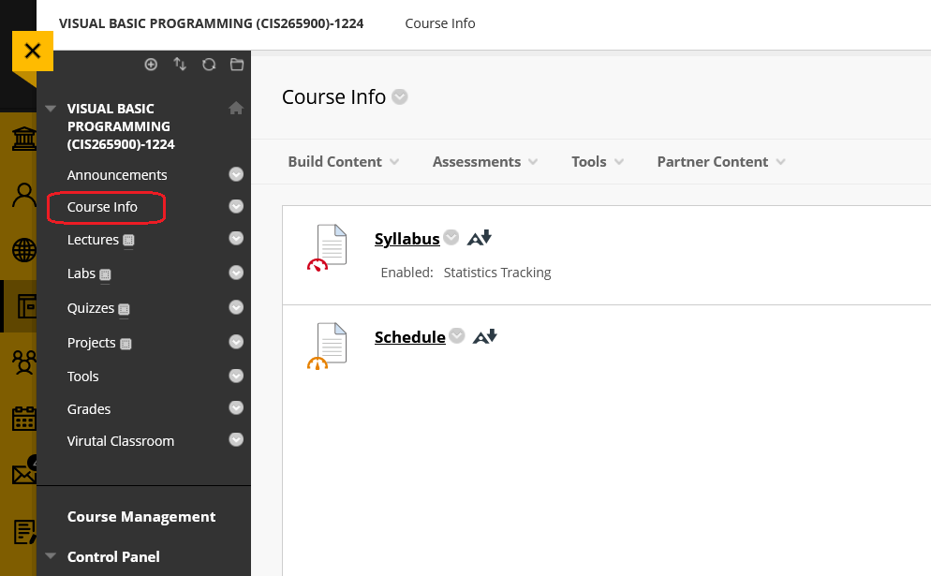
Syllabus & Schedule Review
Located on blackboard…

Slide 8
Introduction to VS & VB
CIS 265 – Visual Basic

Slide 9
Visual Studio
Visual Studio is an integrated development environment (IDE) used to develop computer programs
Visual Studio can be used to develop programs in multiple languages (including but not limited to C, C++, C#)
Obviously, we will be using Visual Basic (VB), more specifically, VB.NET

Slide 10
.NET Framework
.NET is a free and open-source software framework
It is an abstraction that provides generic and common functionality that can be easily modified by user-written code
.NET provides a standard way to develop and deploy applications in a universal and reusable manner
Current Version: .NET 6
.NET can be used to develop:
Windows Applications
Web Applications
Web Services

Slide 11
Applications
Windows Application: A software program designed specifically for the Windows operating system which runs locally (on the user’s computer).
Web Application: A software program that runs in a web browser.
Web Service: A software program available over the internet using standardized XML (to encode communication) to exchange data between other applications regardless of programming language.

Slide 12
Trade Offs: Local vs. Web
Locally installed software is harder to maintain. Considerations of the user’s operating system have to taken into account. Updating software can be difficult or tedious.
When web apps are updated and maintained on the server it is being hosted. Users are “always” on the latest version when connected to the web app. Testing and updating web apps without service interruption can sometimes be challenging. Considerations for which browser and what version of that browser must be made (to include alternative interfaces for mobile devices).

Slide 13
Visual Basic
VB.NET (now just referred to as VB) is an object-oriented programming language
It is the successor to the original VB from the 1990s
VB is often used for programming desktop applications (for Windows) using a simplistic drag-and-drop graphical user interface (GUI)
VB can also be found as the implementation language for Active Server Pages (ASP.NET) applications to produce dynamic web pages.

Slide 14
Object-Oriented Programming
A programming paradigm based on the concept of objects
Object – a combination of variables, functions, and data structures
Everything in VB is considered an object, to include its primitive data types
More on that later…

Slide 15
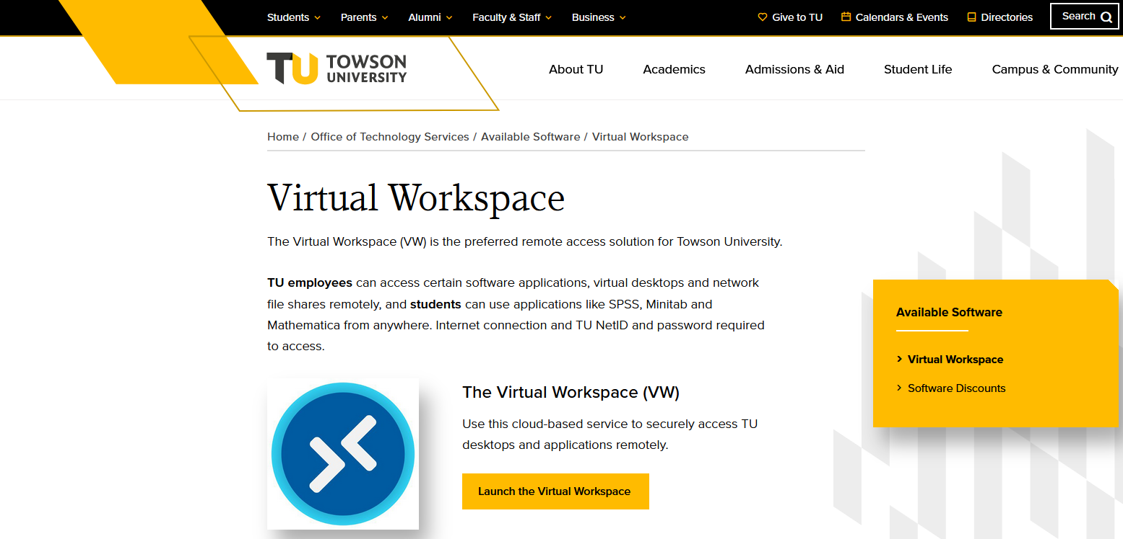
Accessing Visual Studio
To access VS, go to TU’s Virtual Workspace (https://www.towson.edu/technology/software/virtualworkspace.html)
Click on “Launch the Virtual Workspace” button

Slide 16
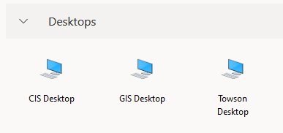
Accessing Visual Studio
In the next webpage, select CIS Desktop
If you do not see this option, contact TU’s Help Desk (Computing Services):
Phone: 410-704-5151 (options 1, 0)
Email: scs@towson.edu
SMS Text: 410-324-7271
In-Person Visit (no appointment necessary): CK 3rd Floor Academic Commons Tech Services Desk, CK 35, TR 123
Chat, Hours & More Info

Slide 17
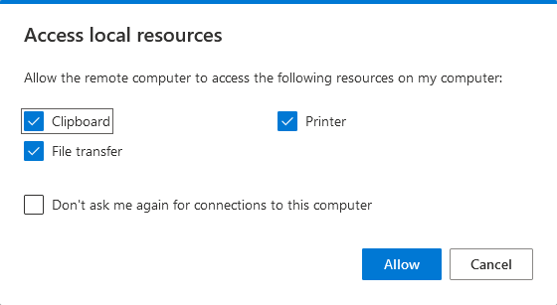
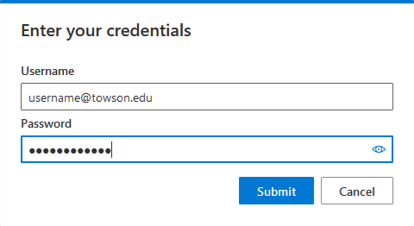
Accessing Visual Studio
Check/uncheck the functionality you’d like, and then click Allow
Log in with your TU credentials and click Submit button.
Your e-mail might be something like username@students.towson.edu

Slide 18
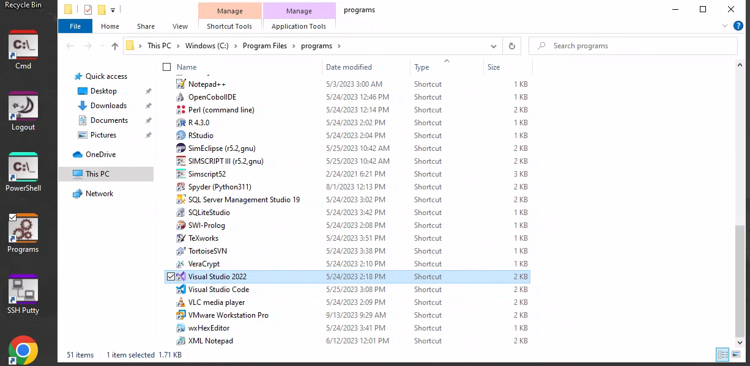
Accessing Visual Studio
Once logged in, open the Programs shortcut from the desktop.
Then scroll down and open Visual Studio 2022.
NOT THIS!!

Slide 19
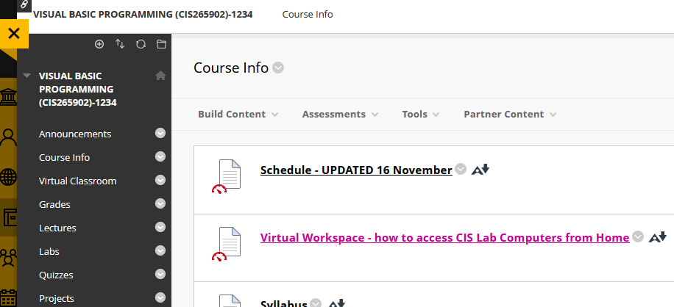
Accessing Visual Studio
For future reference, these steps are repeated on blackboard under Course Info

Slide 20
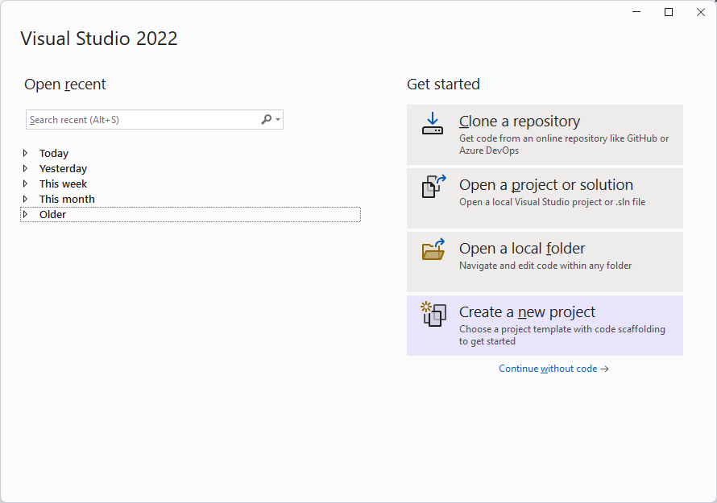
Creating a New Project
Click New Project

Slide 21
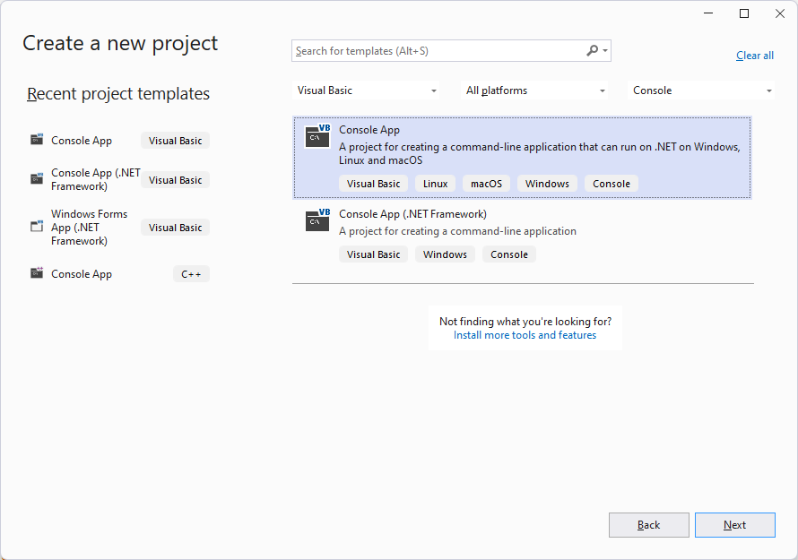
Creating a New Project
The first six labs for this class will be creating console applications.

Slide 22
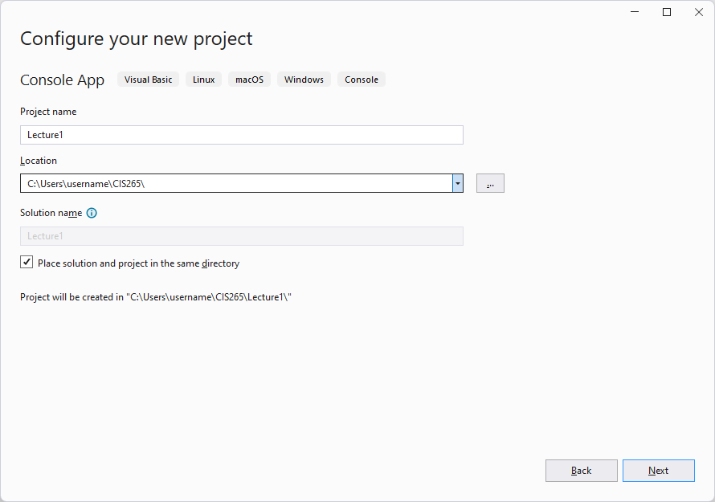
Creating a New Project
Name your project and save it in a location dedicated for this class.

Slide 23
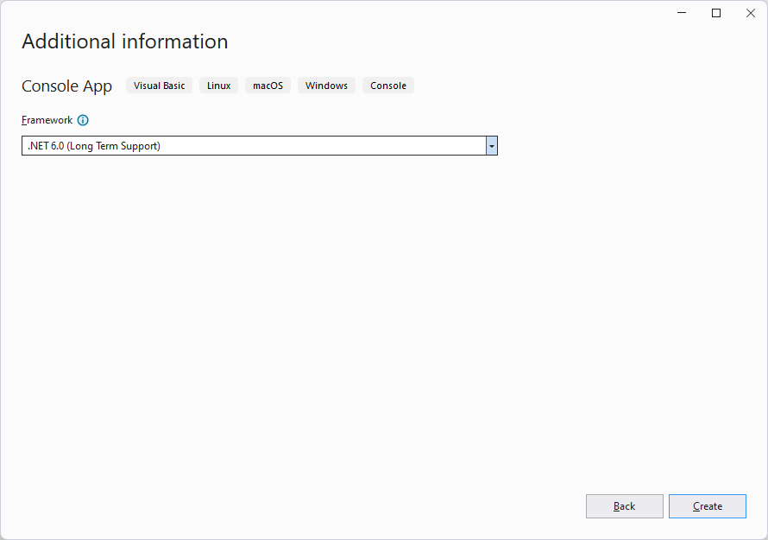
Creating a New Project
Select whatever default option appears in the Framework drop-down list. Click Create.

Slide 24
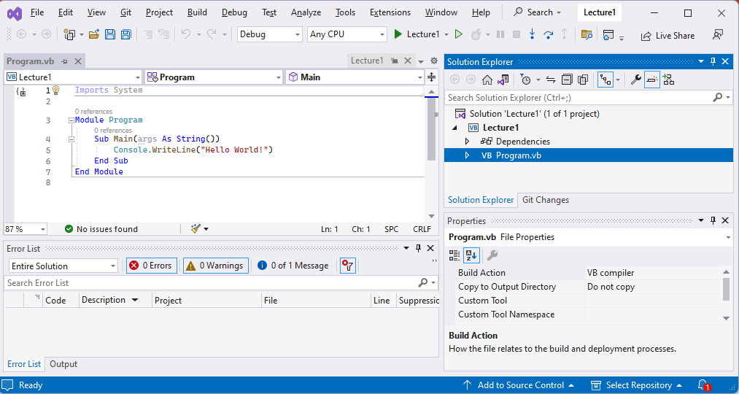
Visual Studio Intro

Slide 25
Visual Studio Intro
Red Section: Displays the contents of the current active file in your project. The active file is what you selected in the solution explorer. Program.vb is the current active file and contains the source code of our program.
Green Section: This is the solution explorer. It lists the files associated within your project.
Blue Section: Contains warnings and errors that occur during an attempt to compile and run the program.
Yellow Section: displays the properties of the selected file within the solution explorer. When we work with GUIs, it will display the properties of that a GUI control (such as height, width, font color, etc.)

Slide 26
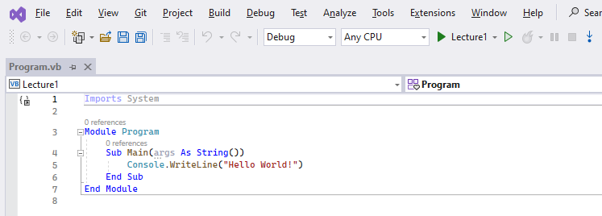
Running the Project
Click the “play” button on the top tool bar. This will run your program (in debug mode). In this class we will not do active debugging.
Our program writes “Hello World” to the console, so we should expect to see that.

Slide 27
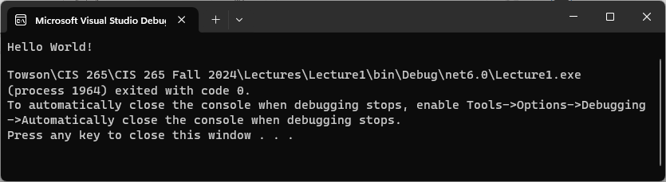
Running the Project
You should see the output “Hello World!”
The program should exit with code 0 (meaning it was successful with no runtime issues)

Slide 28
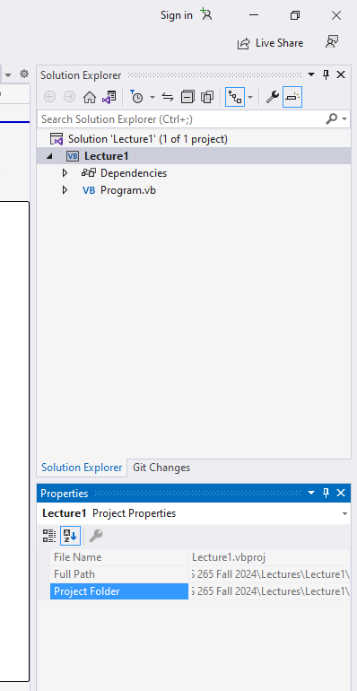
Submitting Assignments
As the syllabus explains, projects are to be submitted within a compressed file (ZIP).
If for whatever reason you forgot where you decided to save your project, you can click the Project Name in the solution explorer and view the Project Folder in the property window.

Slide 29
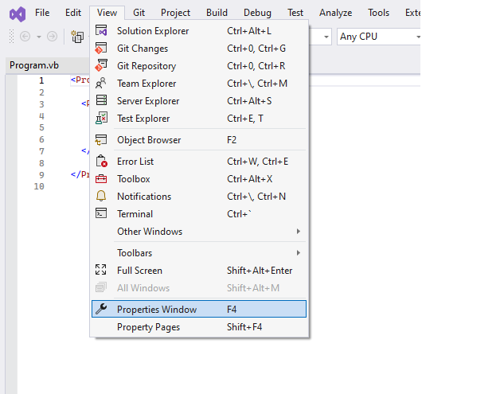
Submitting Assignments
If the properties window is not visible, press F4 or go to View and click Properties Window.

Slide 30
Submitting Assignments
Use file explorer (previously known as windows explorer) to navigate to the folder you save your projects.
Find the folder associated with the project you are submitting.
Right-click on the folder and go to Send to and then click Compressed (zipped) folder

Slide 31
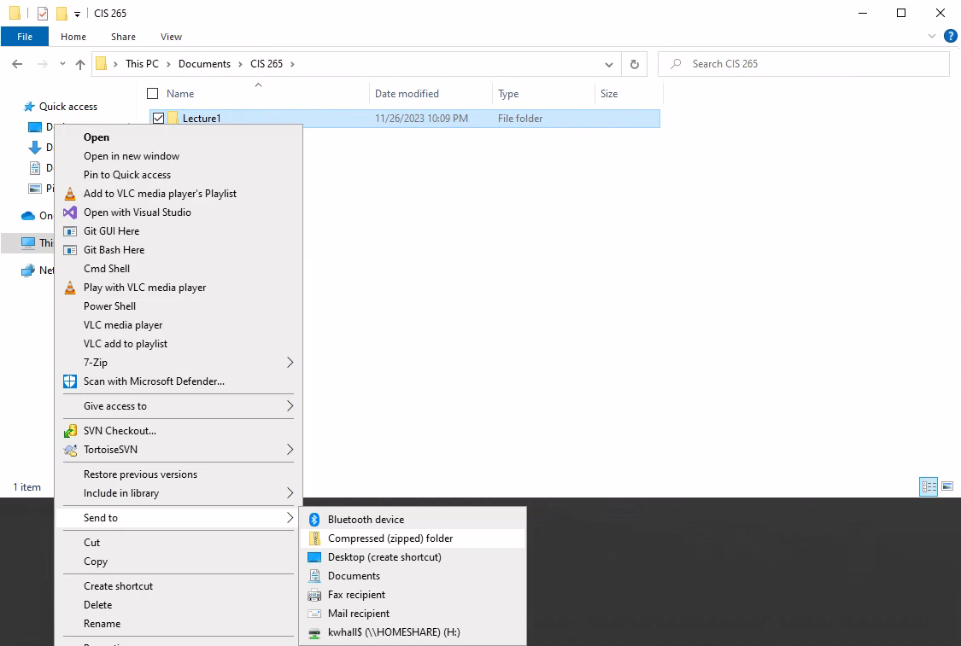

Slide 32
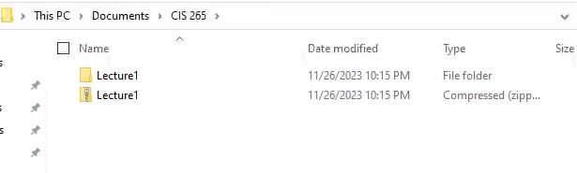

Submitting Assignments
The newly created ZIP file is what you will submit on blackboard.
Notice how the ZIP file has an icon of a folder with a zipper on it.
SUBMIT THE CORRECT FILE OR GET AN F!

Slide 33
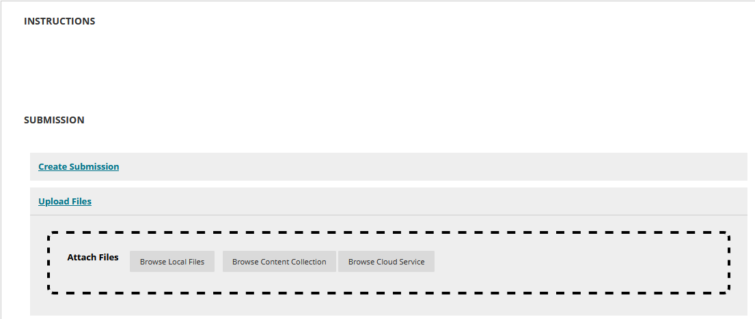
Submitting Assignments
In the assignment’s page on Blackboard, click Upload Files and then click Browse Local Files to search for your ZIP folder.

Slide 34
Lab 1
There is no class meeting this Thursday. Independently work on Lab 1
Your assignment for Lab 1 is to:
Create the Hello World project as demonstrated in this lecture
Put the project in a ZIP file
Submit that ZIP file on Blackboard
If you are having any IT related issues, contact the TU Help Desk (Tech Hub) using the instructions on blackboard. All issues must be resolved prior to week 2’s lecture!

